Slide 1

Punit’s Portfolio Presentation Agenda
Overview/Sitemap (1 min)
Website and its Features (1 min)
Design Process and Decisions (1 min)
Development/Build Process including Challenges, ethical issues, favourite parts, etc. (2 min)
Wireframes/Mockups (1 min)
Components Used (1 min)
Tutorial (1 min)

Slide 2
Site Map
Home page /index.html
#Portfolio
#About me
#Blog
Portfolio page
/portfolio.html
Contact
/contact.html
Blog page
/blog.html
Web Design
About
/about.html
Game Design
Scripts
#Resume
Resume page
/resume.html

Slide 3

Work-in-Progress Portfolio
https://punitdh.github.io/
Notes:
Now this is still a Work-in-progress so I’m just going to go over

Slide 4
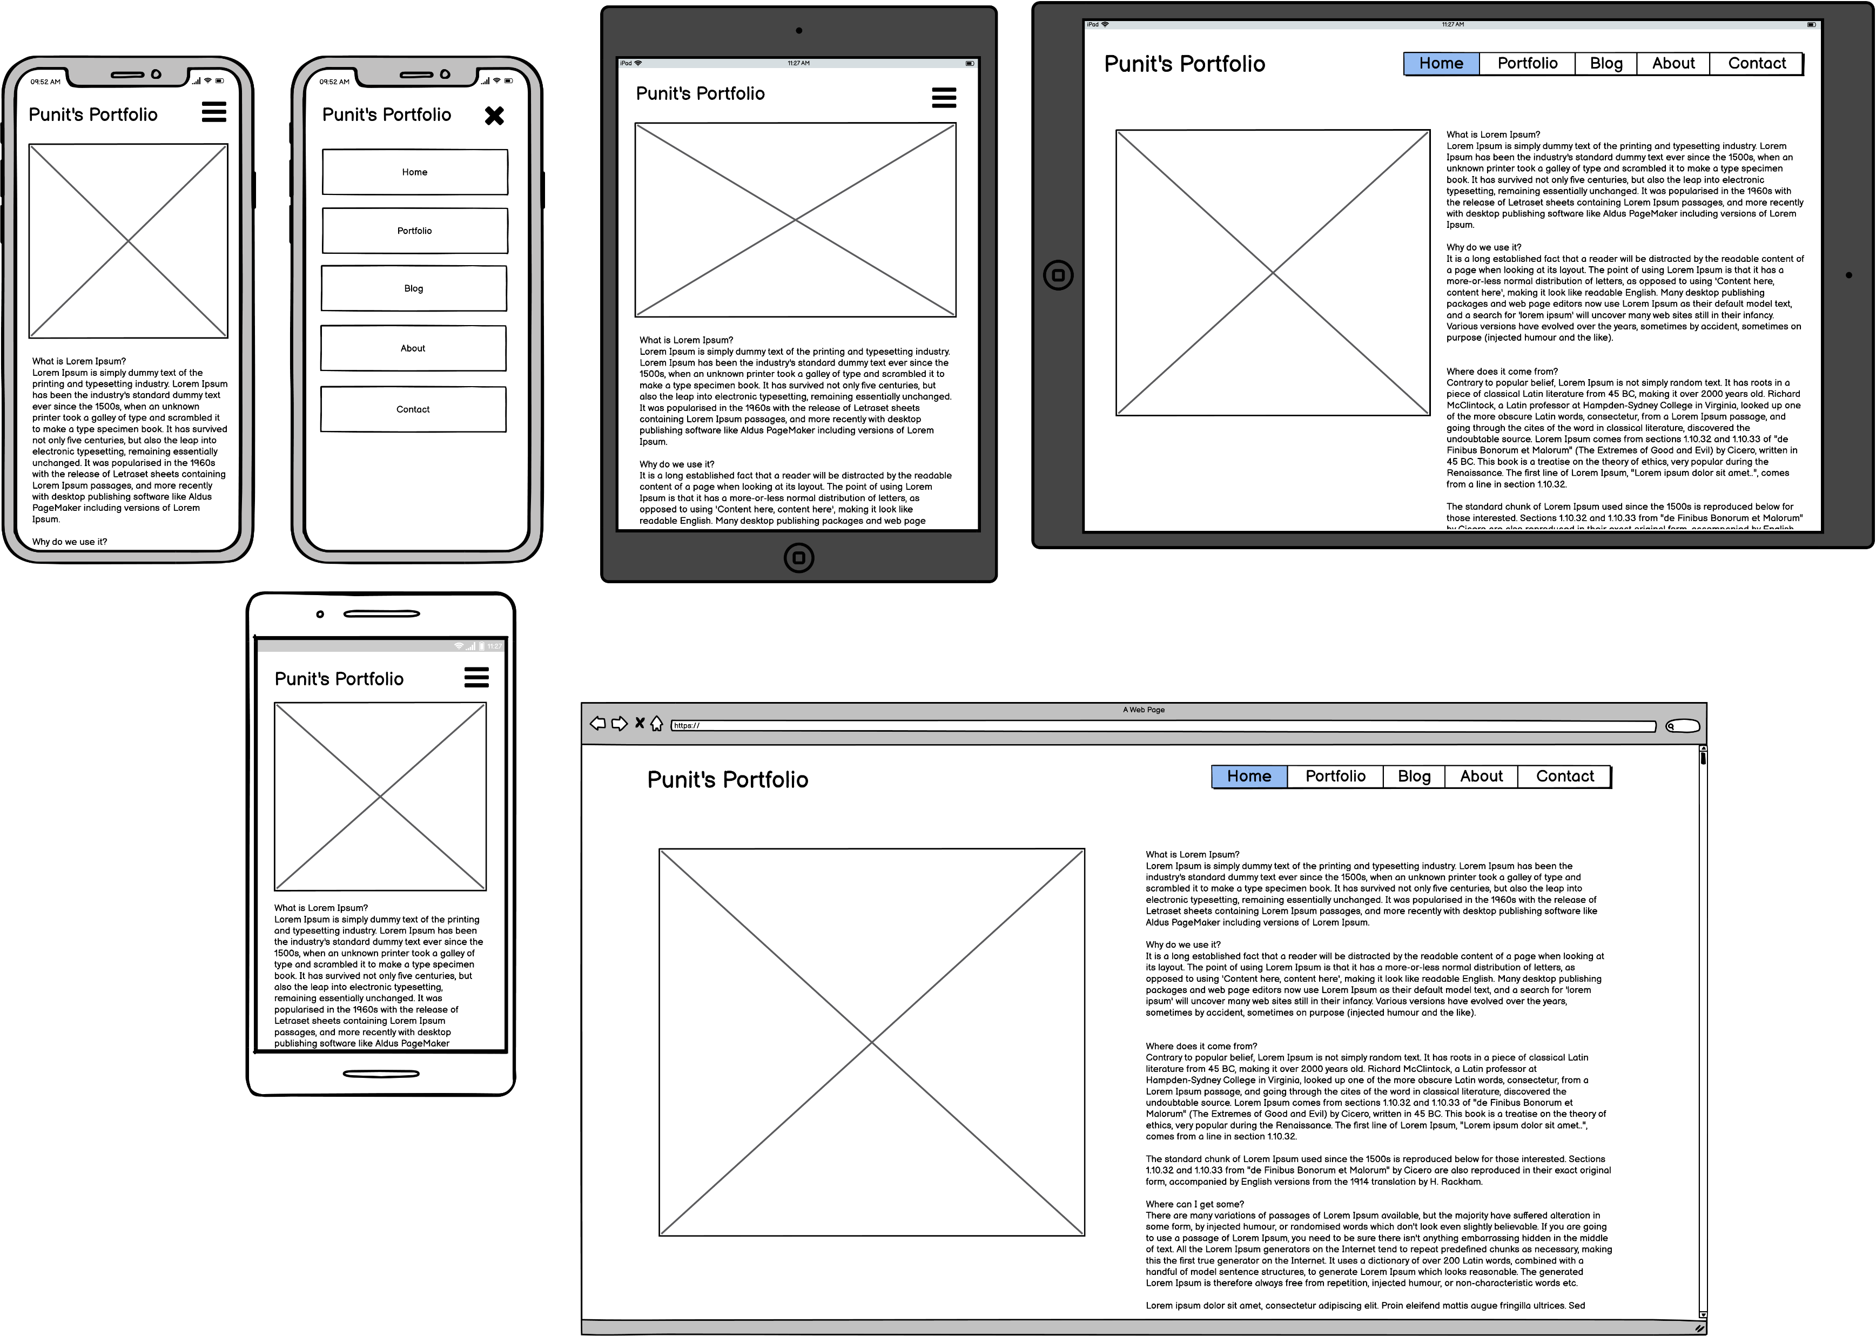
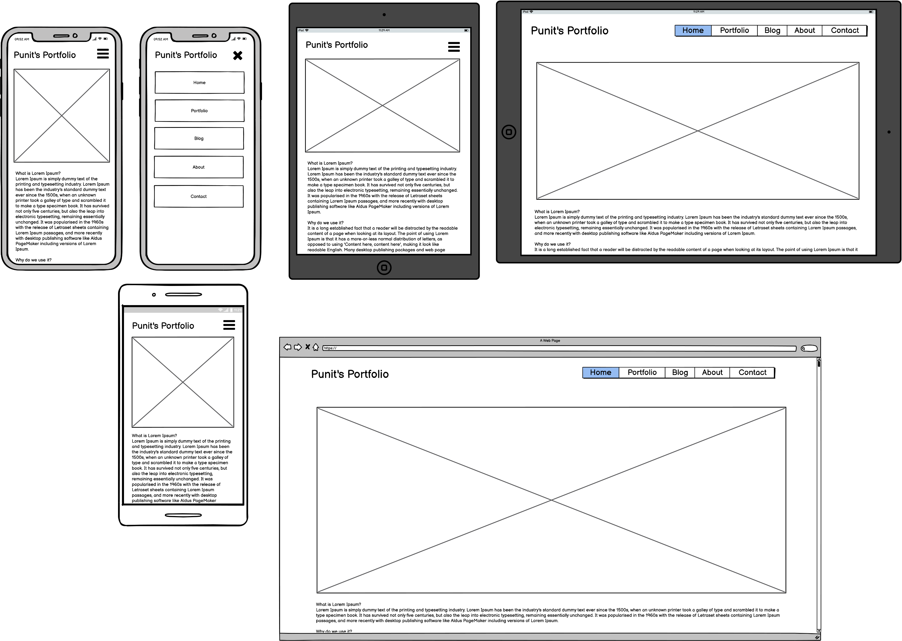
WireFrames

Slide 5
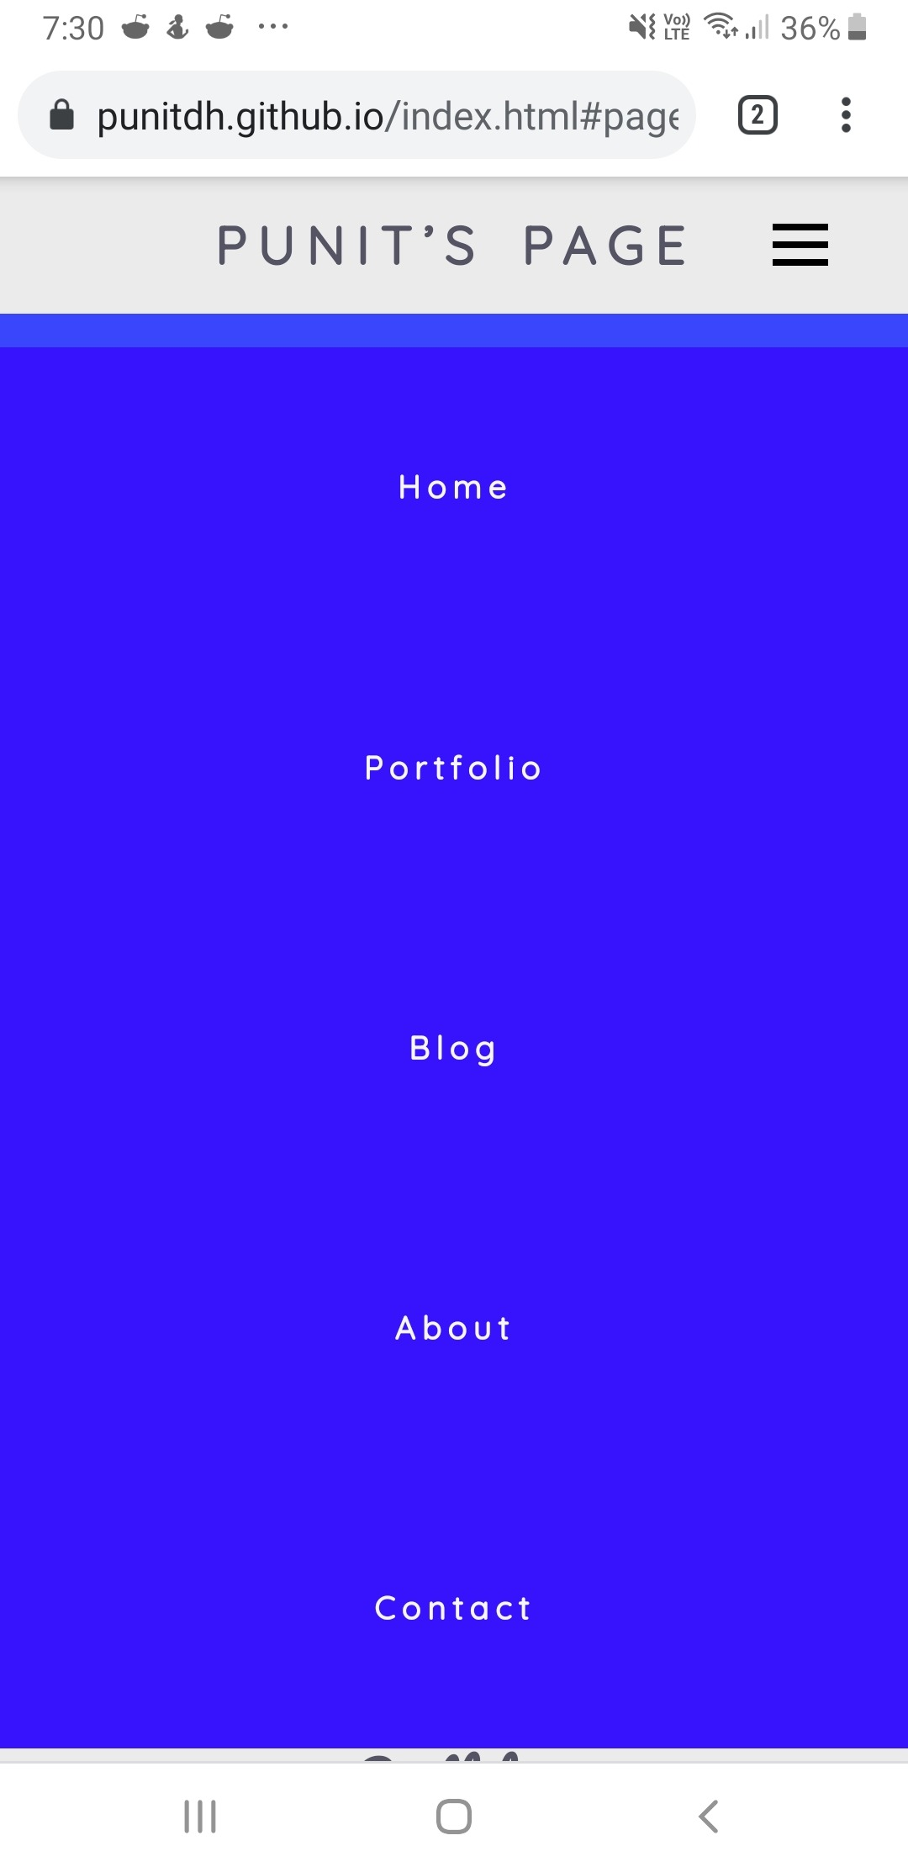
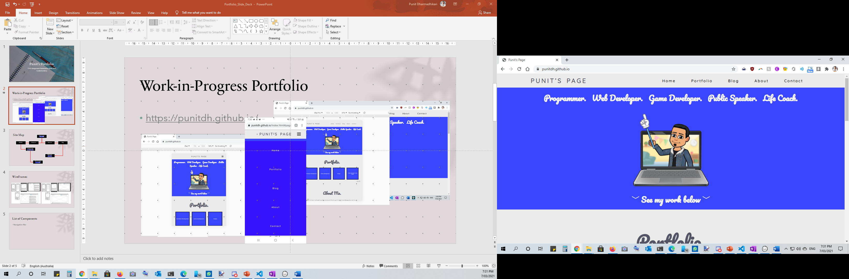
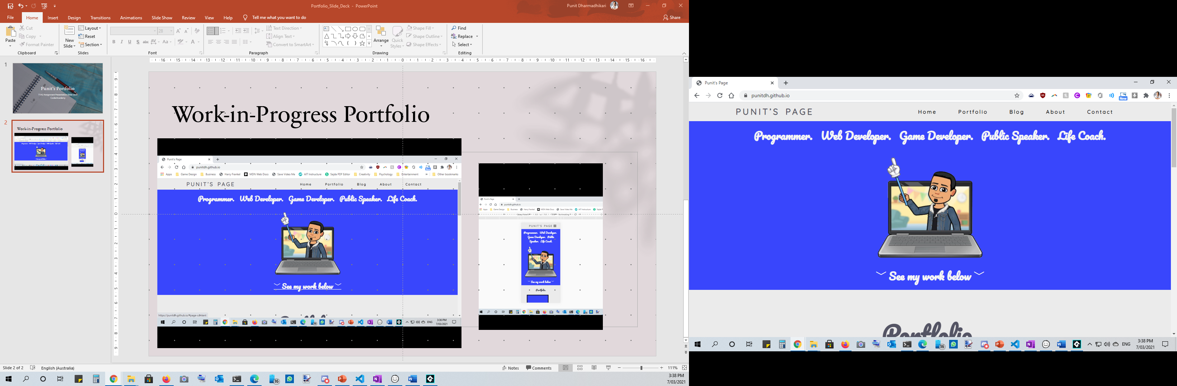
List of Components
Navigation Bar
Graphic
Mouse-over Box Buttons
Footer

Slide 6
A Walkthrough of the Website and its Features

